Slide 1


Slide 2
About Today…
Web Socket
Full Duplex Communication

Slide 3
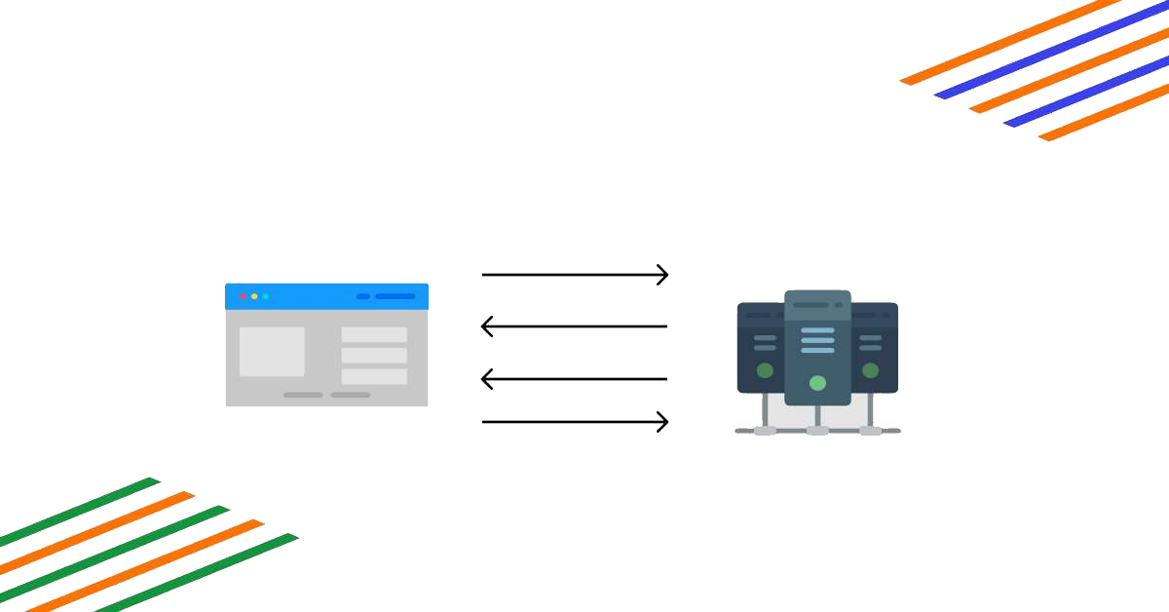
WebSocket

Slide 4
Intro to WebSocket
What is WebSocket?
A communication protocol providing full-duplex communication channels over a single TCP connection
Designed for real-time web applications
Why Use WebSocket?
Real-time data exchange
Efficient communication with low latency
Persistent connection allows continuous data flow

Slide 5

WebSocket vs HTTP
HTTP
Request-response model
New connection for each request
WebSocket
Full-duplex communication
Persistent connection
Ideal for real-time applications like chat, gaming, live notifications

Slide 6
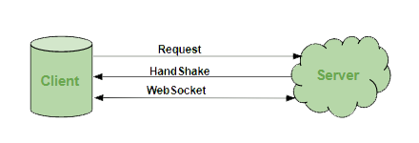
How WebSocket Works
Establishing Connection
Client sends a WebSocket handshake request
Server responds with a WebSocket handshake response
Connection established for bi-directional communication
Communication
Messages can be sent and received by both client and server

Slide 7
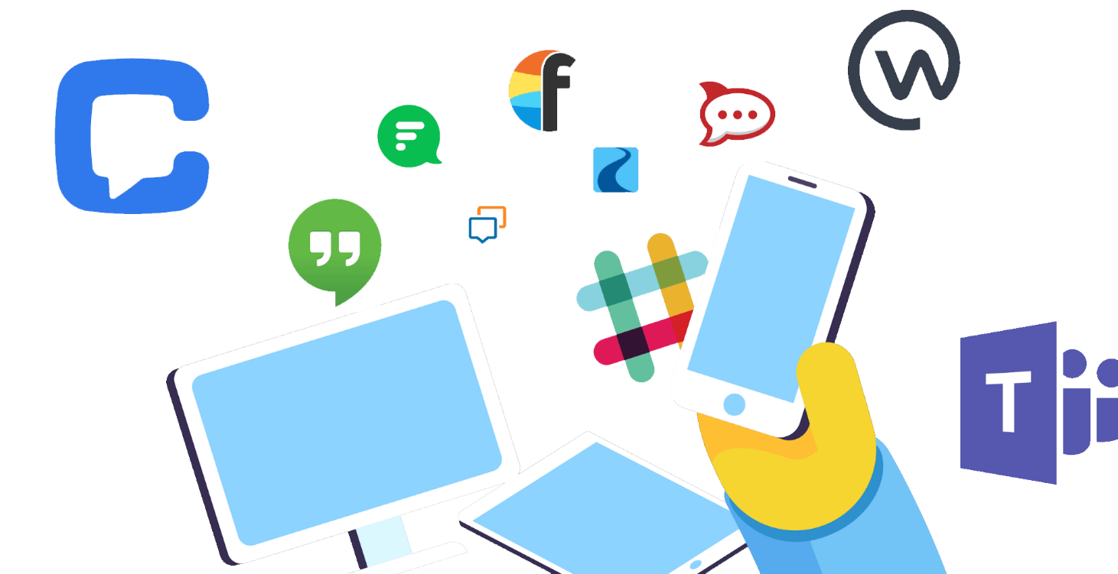
WebSocket Use Cases
Chat Applications
Real-time messaging
Gaming
Multiplayer gaming with real-time updates
Live Notifications
Instant updates for news, social media, etc
Collaborative Tools
Real-time collaboration in documents, coding, etc

Slide 8

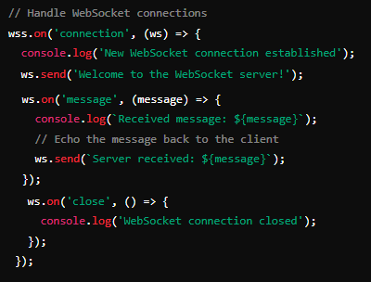
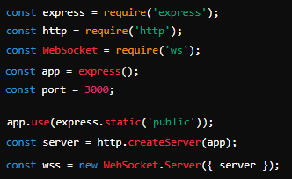

Setting Up WebSocket Server
Install Required Libraries
Basic WebSocket Server
server.js

Slide 9
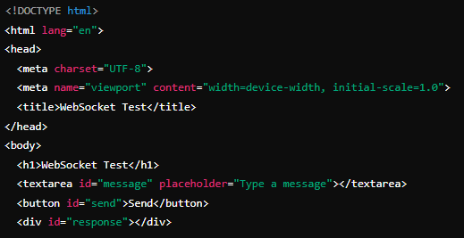
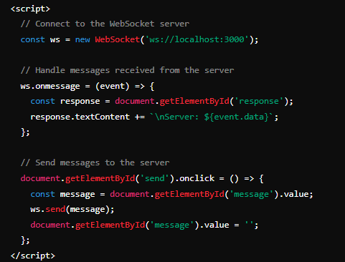

Create a Simple Frontend for Testing
Create a public directory with an index.html file to test the WebSocket server

Slide 10

Start the Server

Slide 11
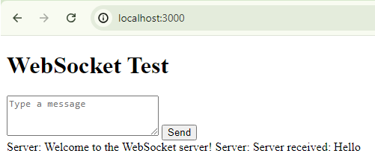
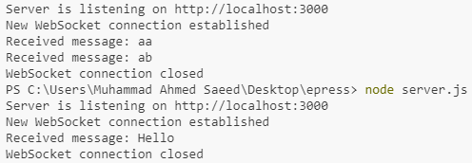
Test the Application
Open your browser and navigate to http://localhost:3000.
You should see the WebSocket test page where you can type messages and see responses from the server

Slide 12

What is the purpose of the WebSocket protocol?
Enables full-duplex, real-time communication between a client (e.g., web browser) and a server over a single, long-lived connection
How do you create a WebSocket server in Node.js using the ws module?
Use the ws module to create a WebSocket server by initializing it with an HTTP server instance
What is the significance of the ws.on('message') event in a WebSocket server?
Handles incoming messages from WebSocket clients, allowing the server to process and respond to client communications
How do you send a message from the WebSocket server to the client?
Use the ws.send() method to send a message from the server to the connected WebSocket client
What method is used to handle the disconnection of a WebSocket client?
The ws.on('close') event is used to handle the disconnection of a WebSocket client

Slide 13

Task
build a simple chat application using WebSocket where users can send and receive messages in real-time

